Slide 1
Opinion Mining
Atasie Oana-Andreea, gr. 341
Ilieș Elena, gr. 341
Petre-Vlad Mihaela, gr. 241

Slide 2
Content
Introduction
What is opinion mining?
Challenges in opinion mining
Experiments and methods used
Conclusion

Slide 3

Introduction
Our project aims to implement algorithms that classify product reviews according to general opinion and rating.
The dataset used is a list of over 30,000 reviews for brands such as Apple, Samsung, OnePlus and Redmi. We have chosen to use the OnePlus Nord 5G reviews.

Slide 4
What is opinion mining?
Opinion mining is a text analysis method that uses natural language processing to identify and extract people’s opinions and sentiments within a text (positive/good, negative/bad, neutral).
Opinion mining is widely used in domains like social media or customer reviews, to determine and categorize opinions about a product, service, or idea.

Slide 5
Challenges in opinion mining
Objectivity or comments with a neutral sentiment tend to pose a problem for systems and are often misidentified.
People can be contradictory in their statements.
Irony and sarcasm often cannot be explicitly trained and lead to falsely labeled sentiments.
Computer programs have trouble when encountering emojis and irrelevant information.

Slide 6
Experiments and methods used
Each review from the dataset has a whole number of stars, from 1 to 5. In our experiments we used two different annotations:
A simple scale of opinion polarity with three categories: bad (1 and 2 stars), neutral (3 stars) and good (4 and 5 stars).
Fine-grained opinion mining with five categories: from ‘very bad’ (1 star) to ‘very good’ (5 stars).
In all the methods of preprocessing used all the words were turned to lowercase and the punctuation was eliminated.

Slide 7
The first experiment
Preprocessing
Eliminated all links, hashtags, mentions and numbers;
Contracted words with apostrophes;
The tokens were extracted using nlp from spaCy;
Eliminated the list of stopwords provided by spaCy, with the exception of the ones that can be used to denote a negative opinions;
Applied lemmatization to the extracted tokens.;
Built a vocabulary of unigrams, bigrams and trigrams using CountVectorizer from sklearn, with the top 800 features ordered by term frequency;
The features were scaled using L2 normalization;

Slide 8
Model
The classification was made using the MLP and SVM with RBF kernel.
80% of the data was used for training and the rest was used for testing.
The MLP was used with the following parameters:
hidden_layer_sizes = (10), activation='relu', solver='adam', alpha=0.01, batch_size='auto', learning_rate='constant', learning_rate_init=0.01, n_iter_no_change=10, max_iter=300, tol=0.00001, shuffle=True, random_state=10, warm_start=True
The SVM was used with the following parameters:
C=1, kernel='rbf', gamma='scale', tol=0.0001, class_weight=None, max_iter=-1, random_state=10

Slide 9
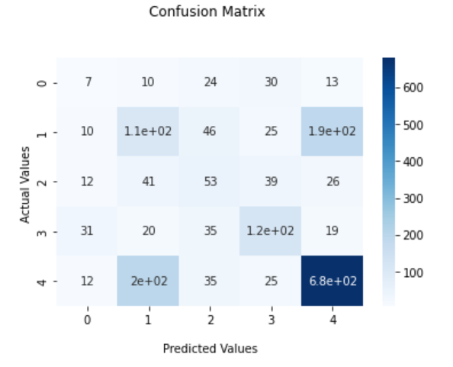
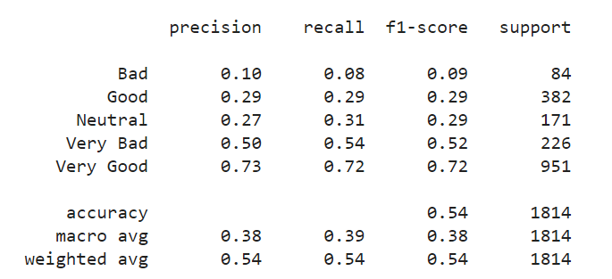
Results for 5 labels with MLP
Confusion Matrix
Metrics

Slide 10
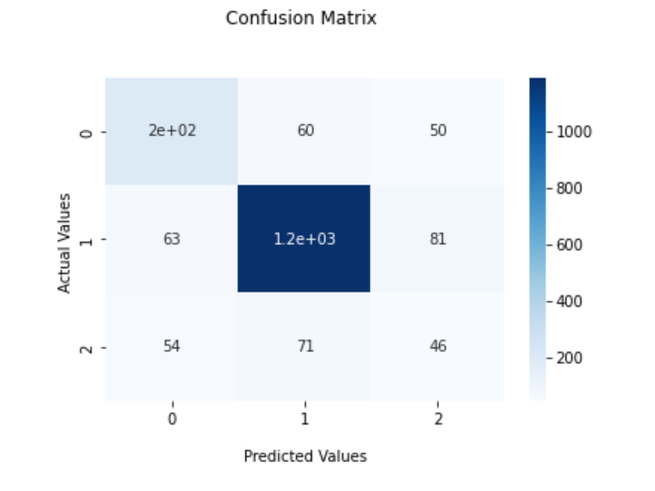
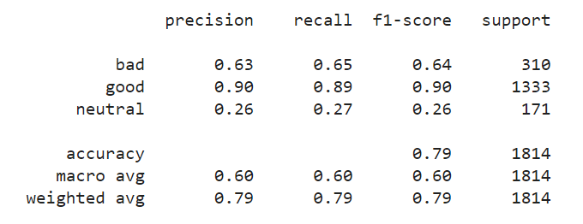
Results for 3 labels with MLP
Confusion Matrix
Metrics

Slide 11
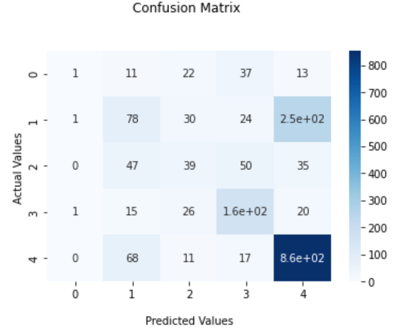
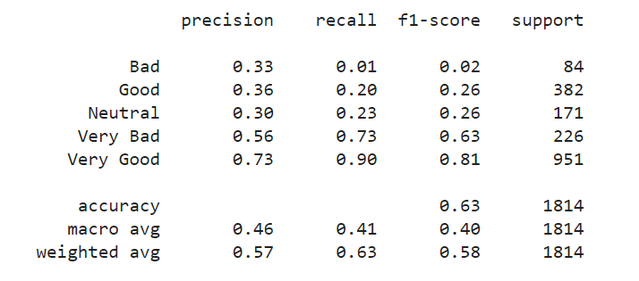
Results for 5 labels with SVM
Confusion Matrix
Metrics

Slide 12
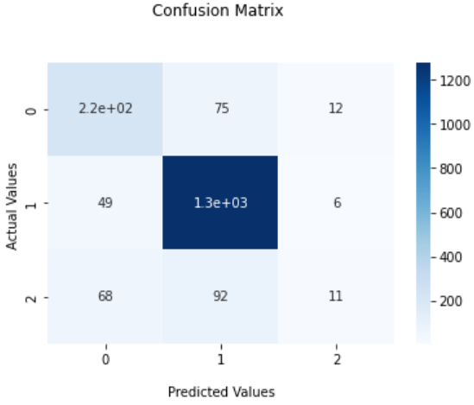
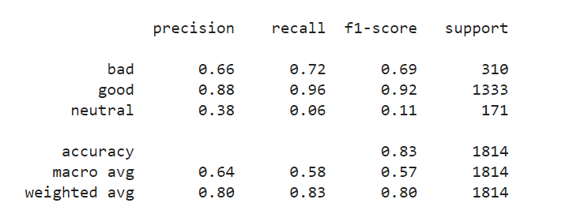
Results for 3 labels with SVM
Confusion Matrix
Metrics

Slide 13
The second experiment
This experiment is similar to the first one, the only thing changed being the vocabulary built with CountVectorizer. This time the vocabulary consists of the top 600 bigrams and trigrams.

Slide 14
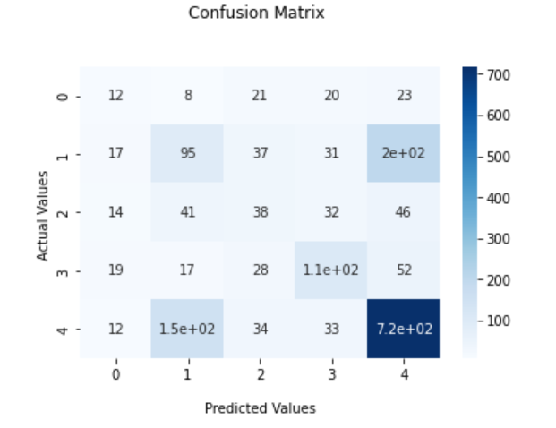
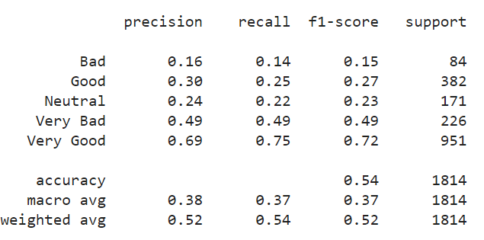
Results for 5 labels with MLP
Confusion Matrix
Metrics

Slide 15
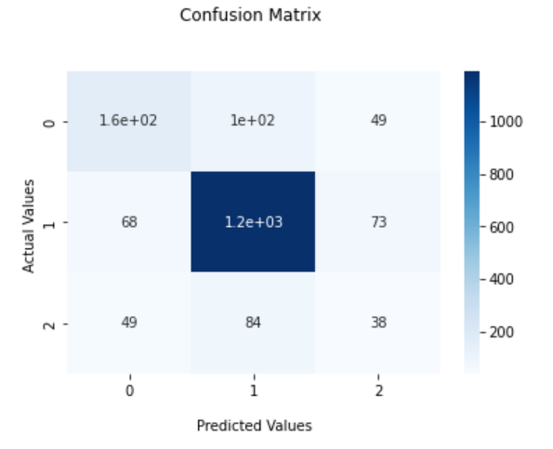
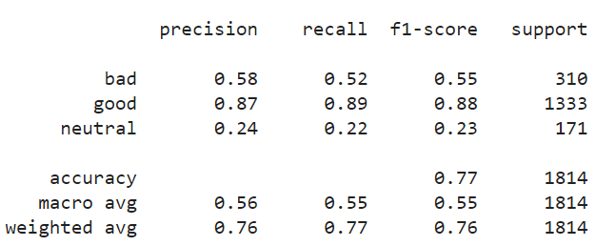
Results for 3 labels with MLP
Confusion Matrix
Metrics

Slide 16
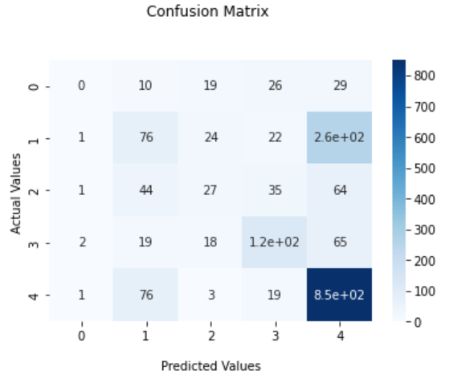
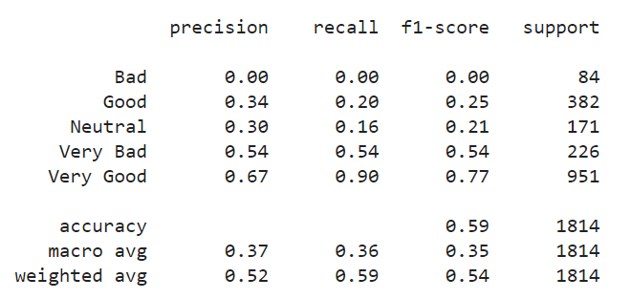
Results for 5 labels with SVM
Confusion Matrix
Metrics

Slide 17
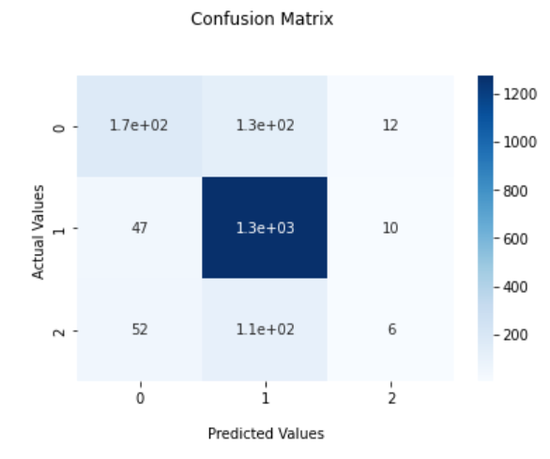
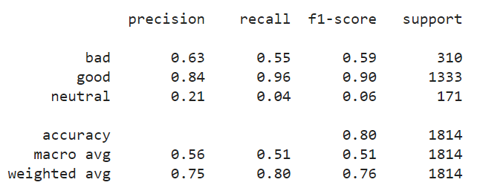
Results for 3 labels with SVM
Confusion Matrix
Metrics

Slide 18
The third experiment
Preprocessing
Endlines and multiple spaces were removed;
Numbers have been transformed into letters;
Stemming and TfidfVectorizer were used on the resulting data;
TfidfVectorizer parameters:
preprocessor=preprocessing_function, tokenizer=tokenize, token_pattern=None, max_features=7000, binary=True
The features were scaled using L1 normalization;

Slide 19
Model
The classification was made using linear SVM.
80% of the data was used for training the rest was used for testing.
The SVM was used with the following parameters:
C=10.0, kernel='linear', tol=0.01

Slide 20
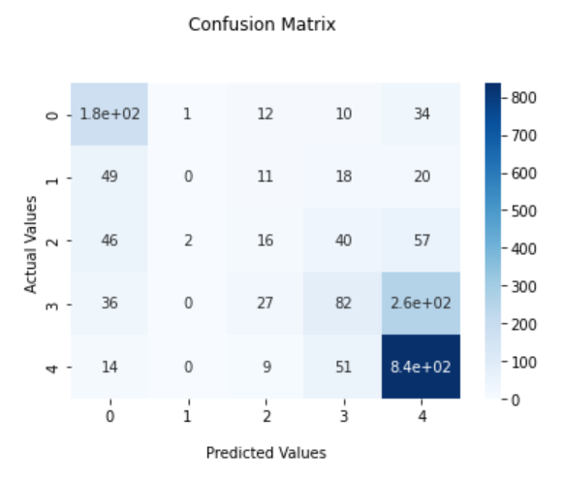
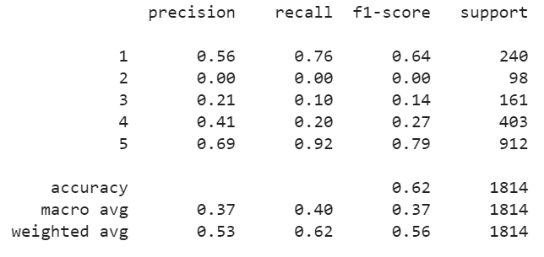
Results for 5 labels
Confusion Matrix
Metrics

Slide 21
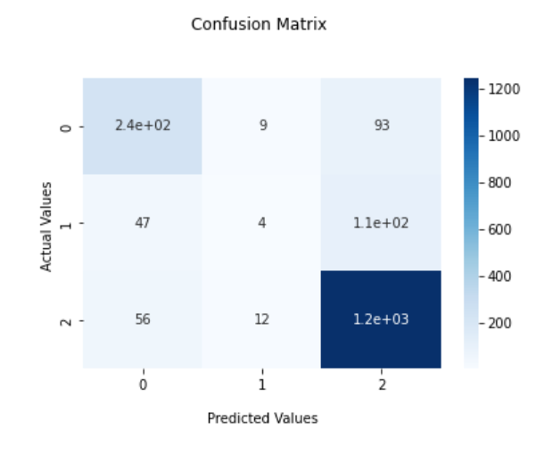
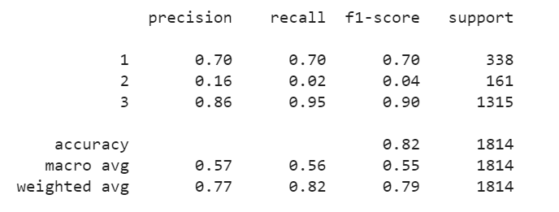
Results for 3 labels
Confusion Matrix
Metrics

Slide 22
The fourth experiment
Preprocessing
Endlines, emoji and multiple spaces were removed;
Numbers have been transformed into letters;
Using the Tokenizer class in the keras module, the texts were vectorized, turning them into a sequence of integers by associating a dictionary index with each word in the text;
In order to have the data of the same length, the chosen length being 300, a padding was added to each representation of the data;

Slide 23
Model
The classification was made using the CNN.
80% of the data was used for training, 10% was used for validation and the rest was used for testing.
The CNN model includes an embedding layer with an output dimension of 100, 1d conventional layers with ReLU as activation function and 1d max pooling layers used to reduce the dimensions of the features.
Adam optimizer was used to modify neural network attributes to reduce losses.

Slide 24
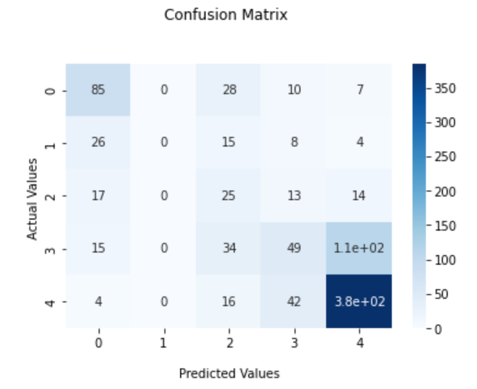
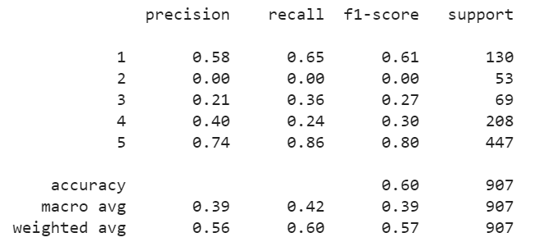
Results for 5 labels
Confusion Matrix
Metrics

Slide 25
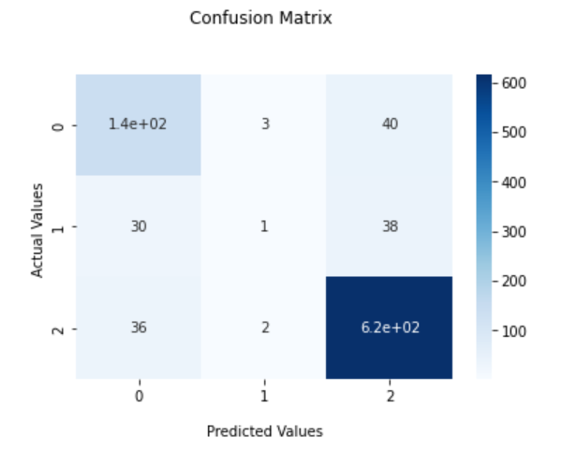
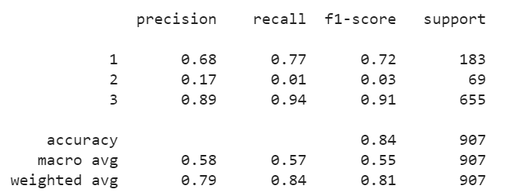
Results for 3 labels
Confusion Matrix
Metrics

Slide 26
Conclusion
Fine-grained opinion mining has a low accuracy - approximately 60% - because the trained models cannot distinguish between the categories ‘bad’ and ‘very bad’ and the categories ‘good’ and ‘very good’.
With 3 categories the trained models give a much higher accuracy - approximately 80%. The result reflects reality, since people can more easily categorize a review as being generally ‘good’ or ‘bad’, rather than its precise opinion.

